Slide 1


Predict Conversion in Digital Marketing Dataset
Presentation
By
Ome Ebere Precious
Covenant University Data Analysis Hub (CEDS)
Data Analytics Intermediate Class
JULY, 2024.
EO

Slide 2

Overview
This dataset provides a comprehensive look at various factors that can influence conversion rates in digital marketing campaigns. By analyzing demographic information, marketing tactics, customer engagement, and historical data, we can uncover insights to optimize our strategies and drive better results.
1
Comprehensive Dataset
The dataset consist of Customer ID, Age, Gender, Income, Campaign Channel, Campaign Type, Ad Spend, Click Through Rate, Conversion Rate, Website Visits, Pages Per-Visit, Time On-Site, Social Shares, Email Opens, Email Clicks, Previous Purchases, Loyalty Points, Advertising Platform, Advertising Tool, Conversion.
2
Actionable Insights
The analysis will uncover strategies to improve conversion rates and optimize marketing efforts.

Slide 3
Features
Demographic Information
User Characteristics
Interests and Preferences
Psychographic Factors
Age, gender, location, household income, and other personal details that can influence buying behavior.
Data on users' browsing history, search queries, and past purchases to understand their interests.
Insights into users' values, attitudes, and lifestyle choices that shape their decision-making.

Slide 4

Customer Engagement Variables
Website Interactions
Social Media Interactions
Metrics on user visits, page views, time on site, and engagement with different content.
Shares, likes, comments, and other social engagement signals across platforms.
1
2
3
Email Engagement
Open rates, click-through rates, and subscriber activity for email marketing campaigns.

Slide 5




Historical Data
Past Campaigns
Record of previous digital marketing efforts, including their objectives, strategies, and outcomes.
Conversion Trends
Historical data on conversion rates, sales, and revenue generated from past marketing initiatives.
Market Shifts
Insights into industry changes, consumer behavior, and other external factors that may have influenced past performance.

Slide 6




Target Variable
Conversion Rate
Revenue Impact
Optimization Potential
The primary metric we aim to predict, indicating the percentage of visitors who take a desired action, such as making a purchase or signing up for a service.
Accurately predicting conversion rates can have a significant impact on revenue generation and profitability for digital marketing campaigns.
The model's predictions can guide strategic decisions and optimize marketing efforts to improve overall performance.

Slide 7

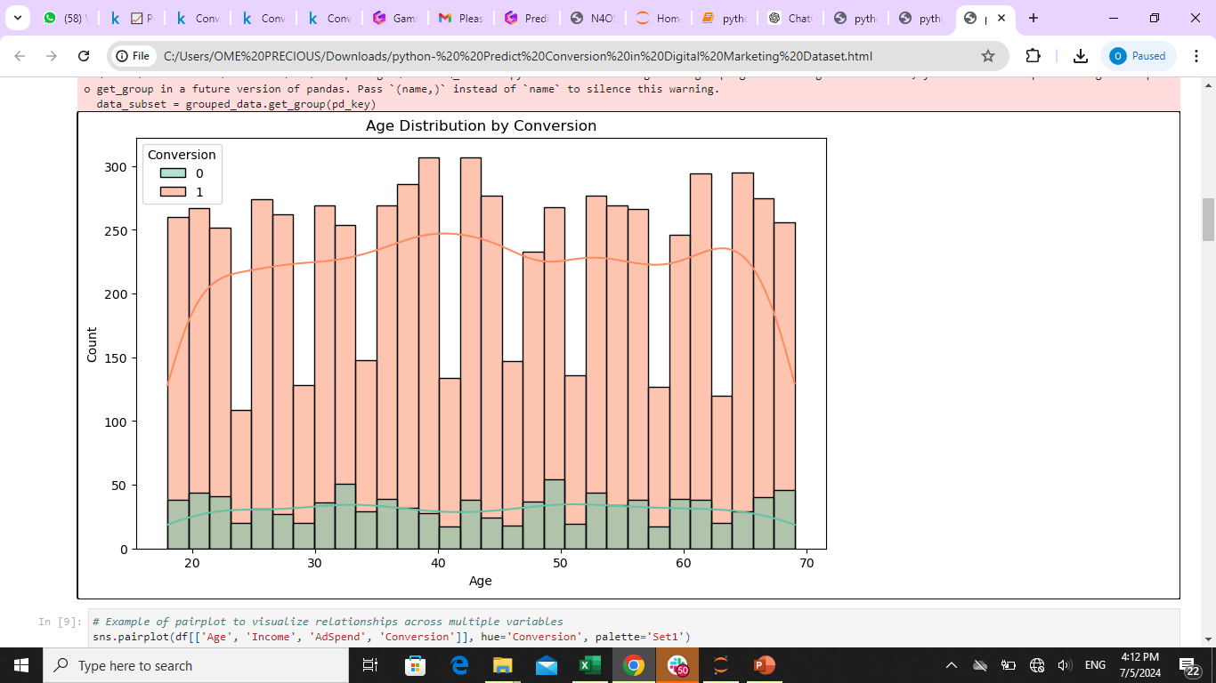
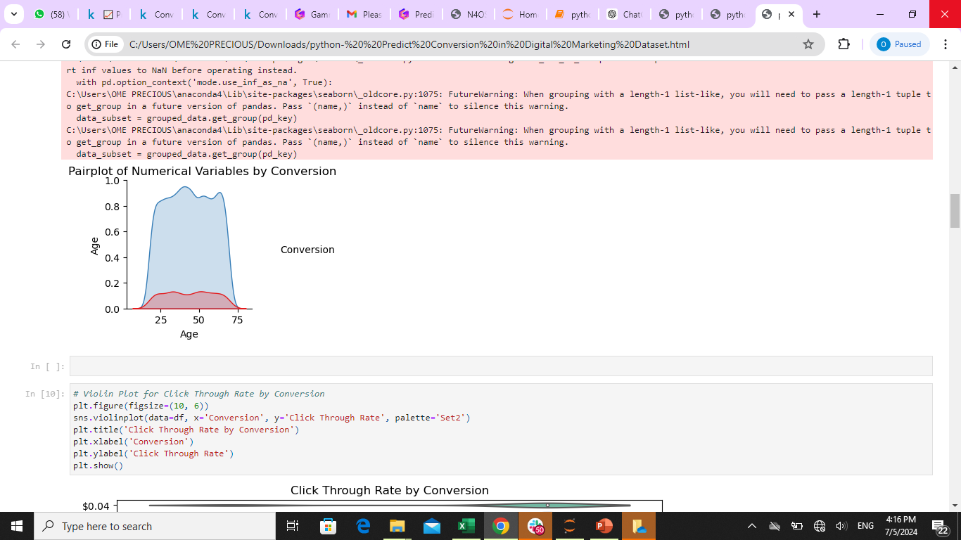
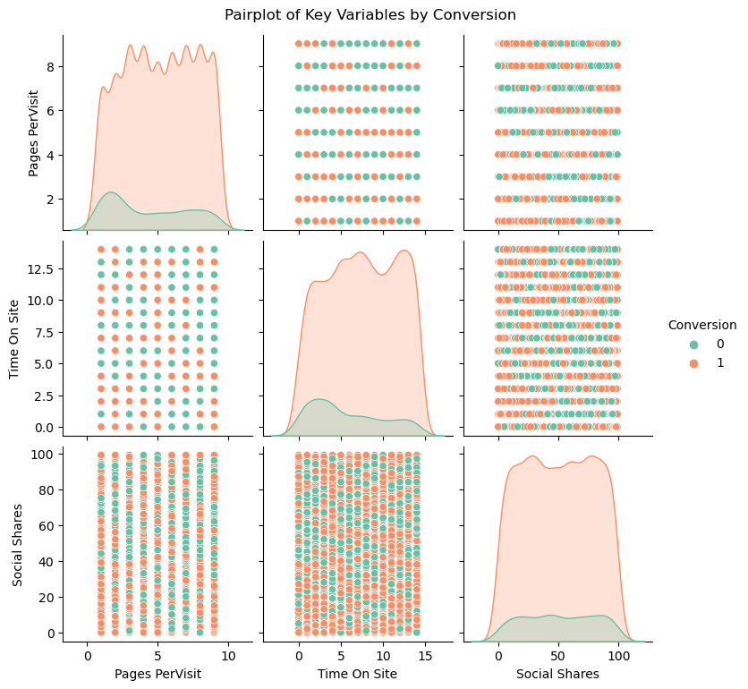
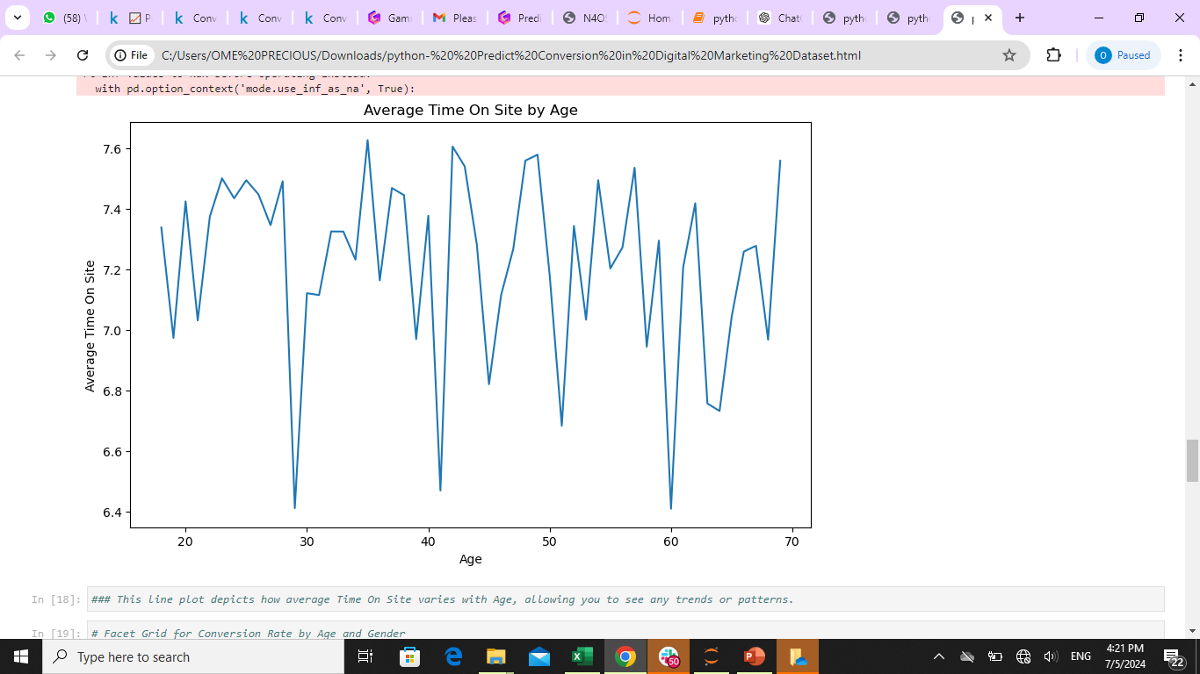
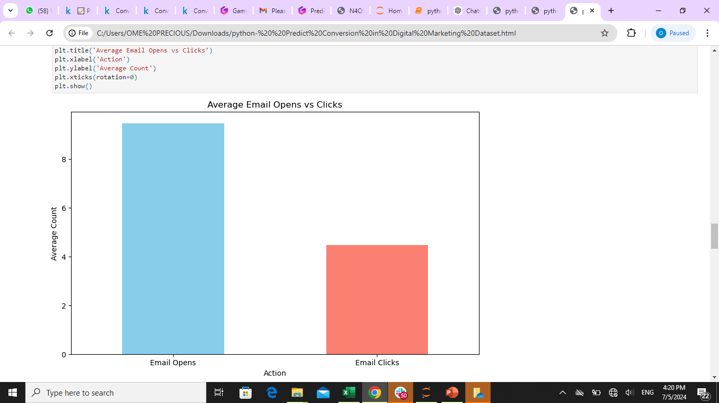
DATA VISUALIZATION

Slide 8

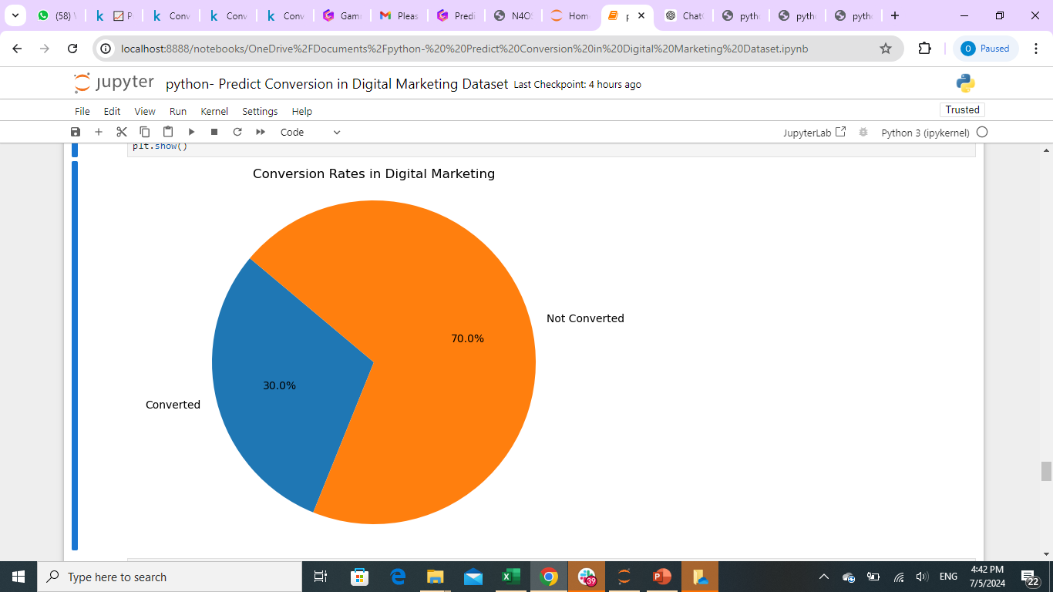
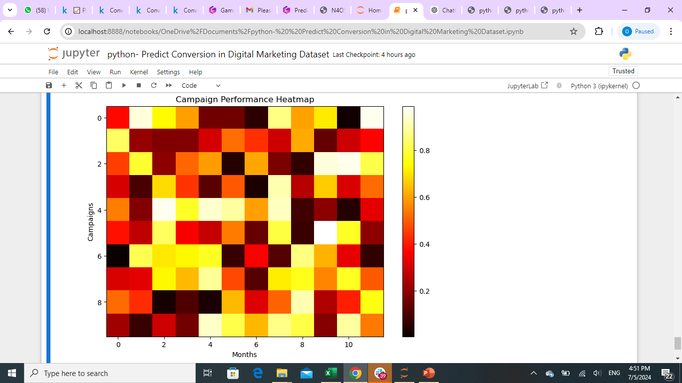
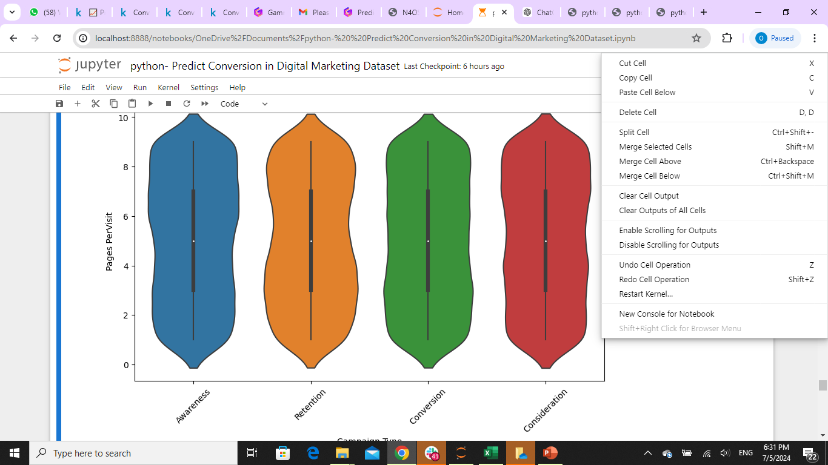
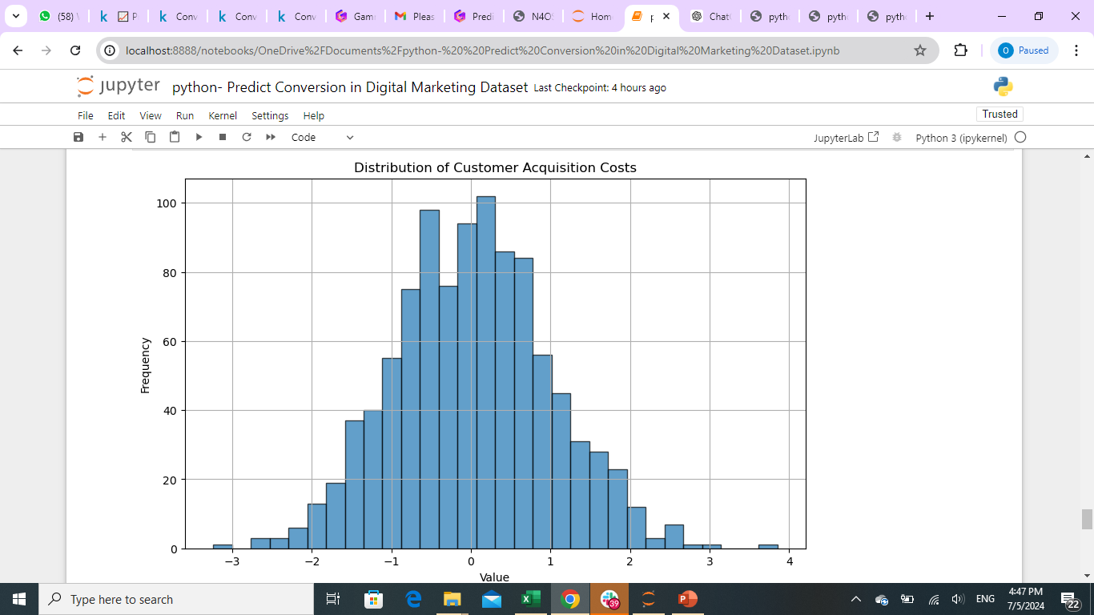
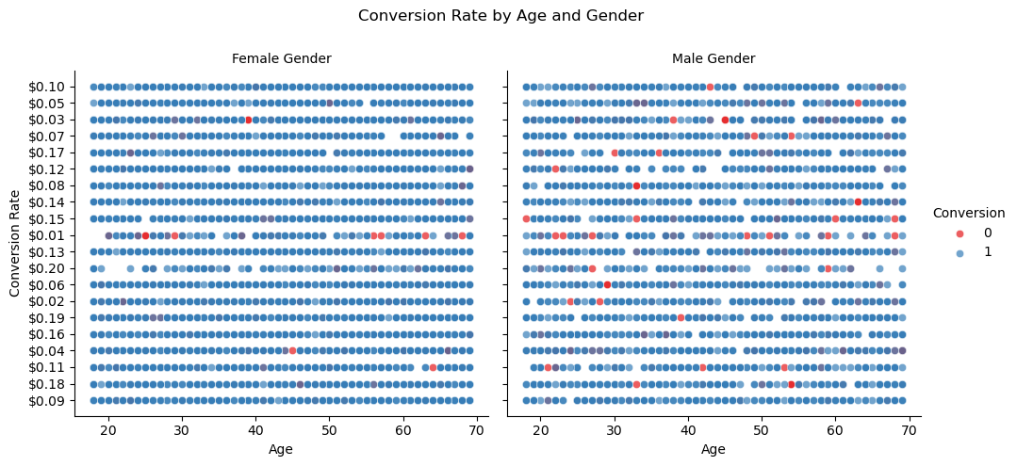

Slide 9
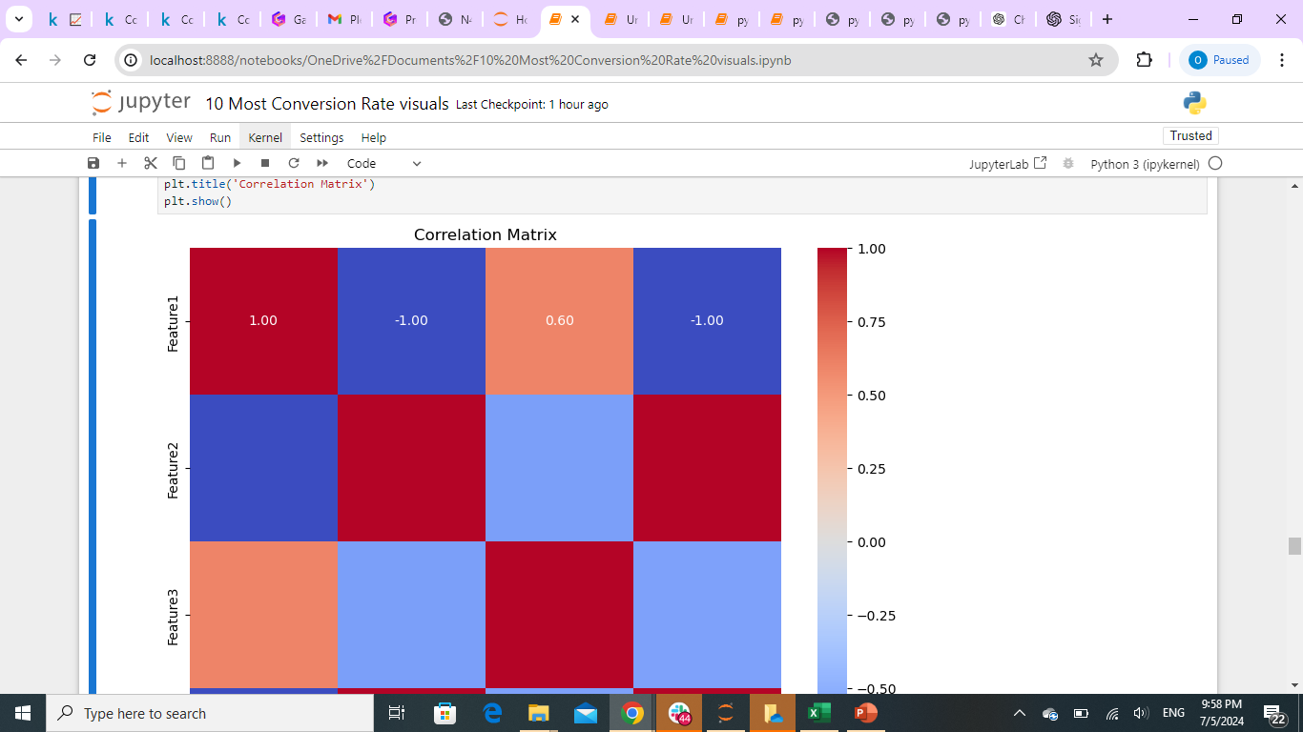
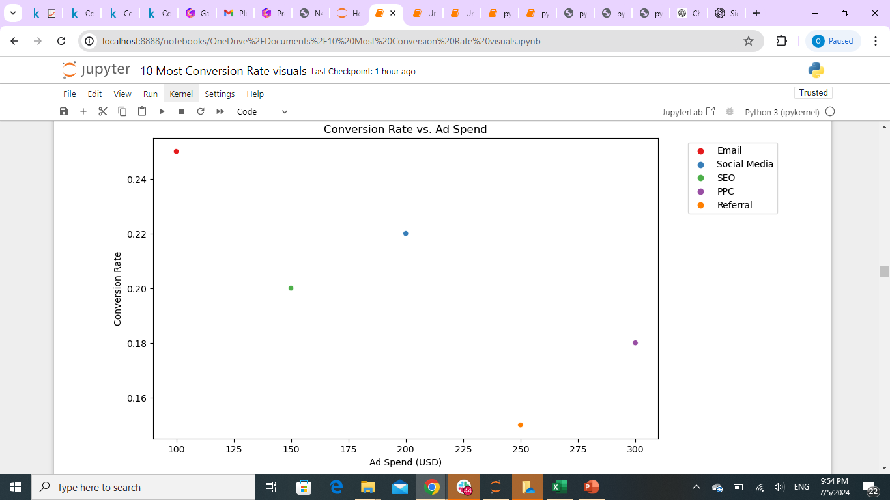
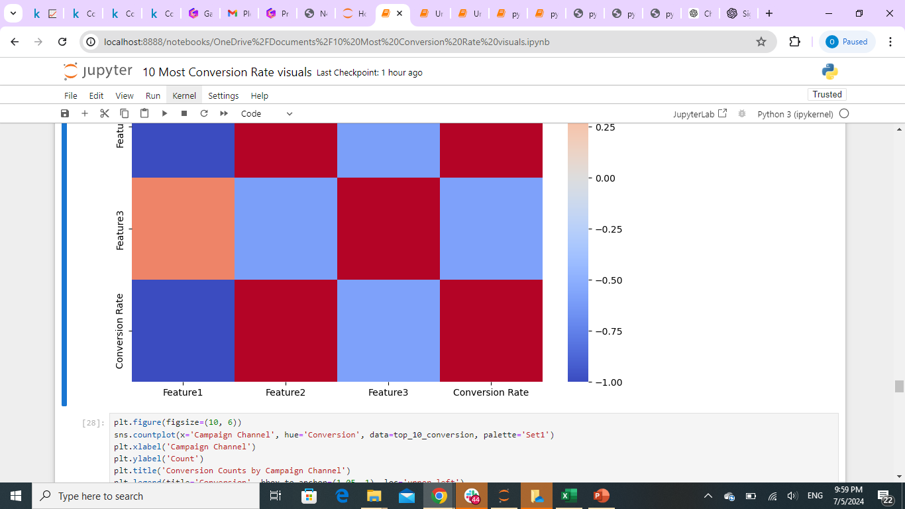
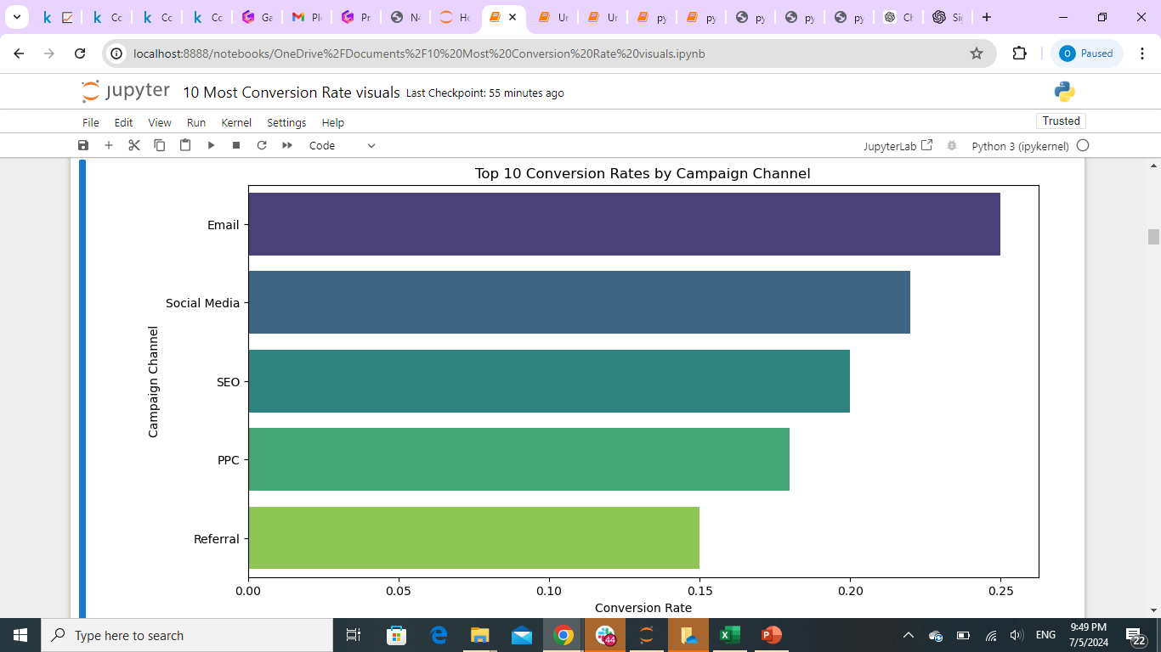
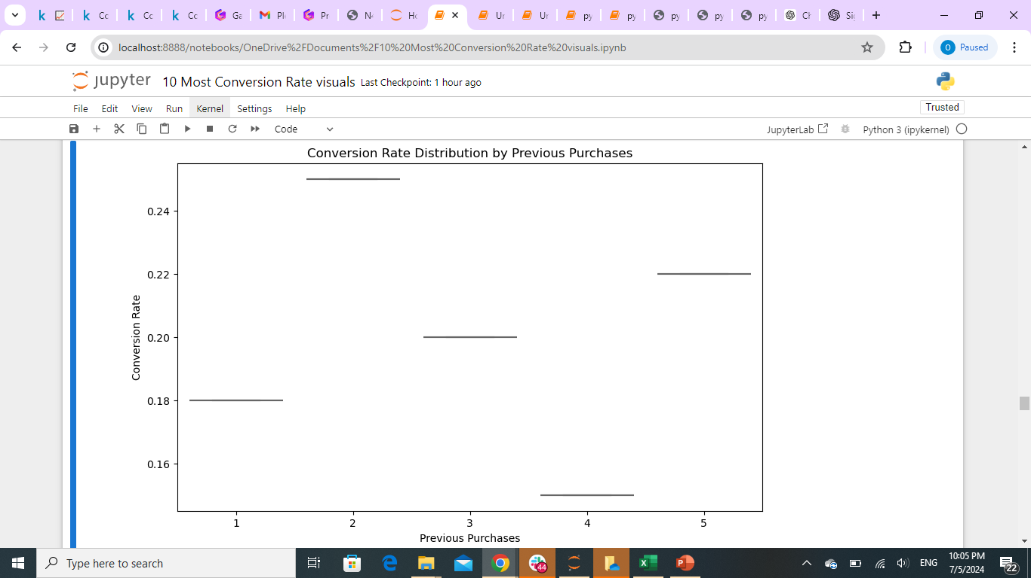
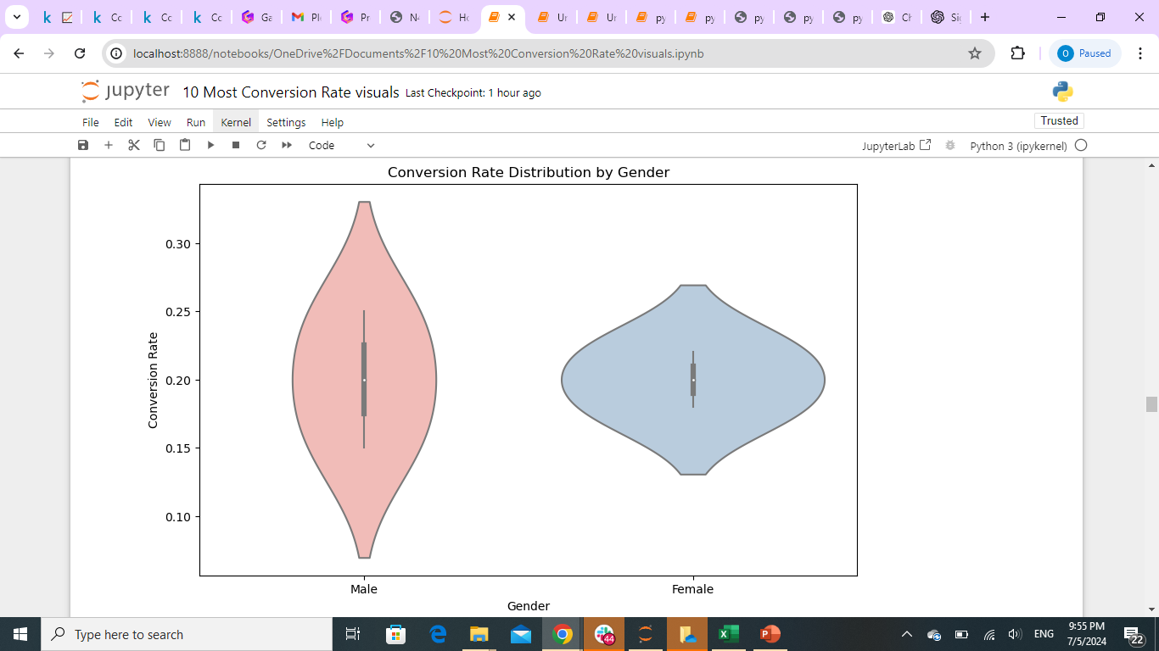
Top 6 Conversion Rate

Slide 10
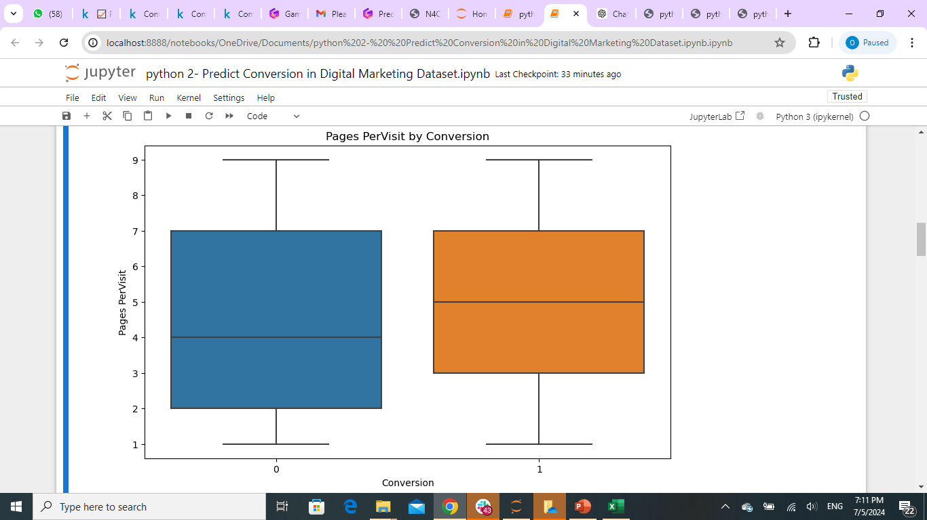
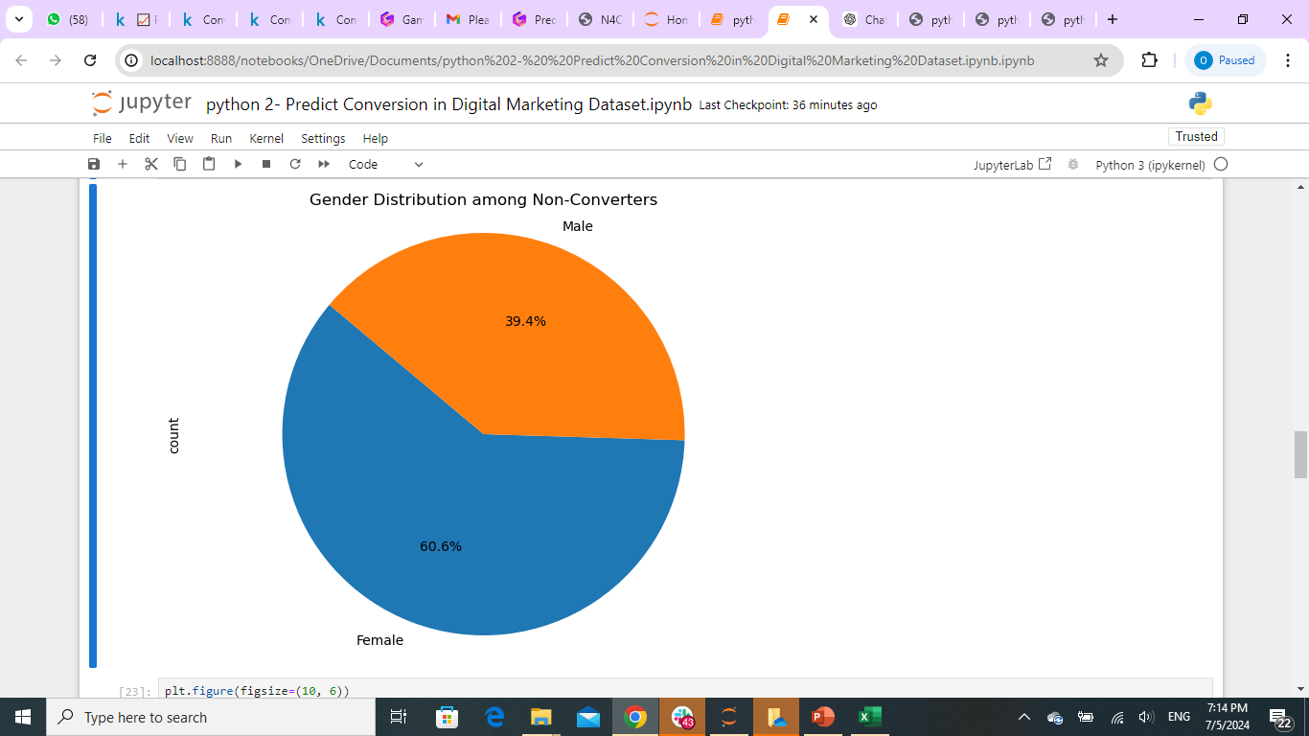
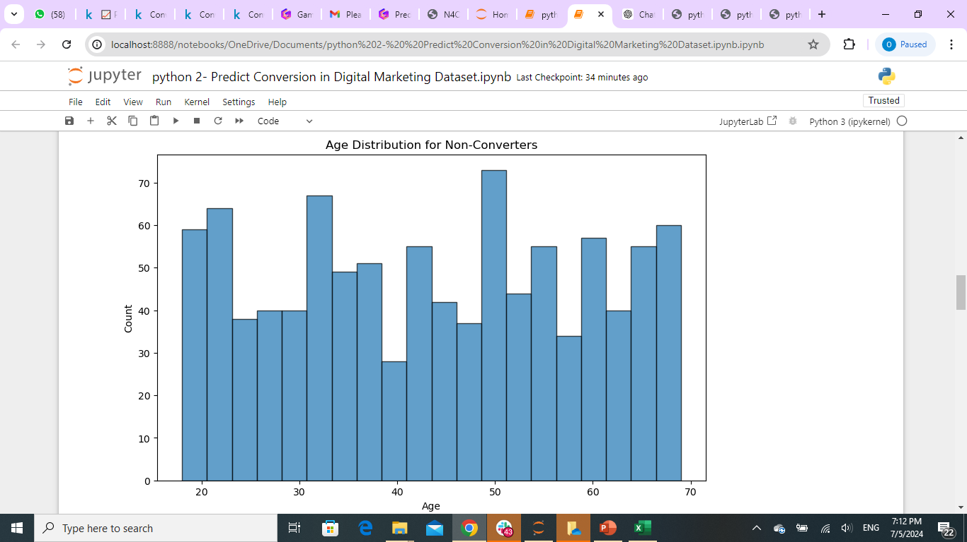
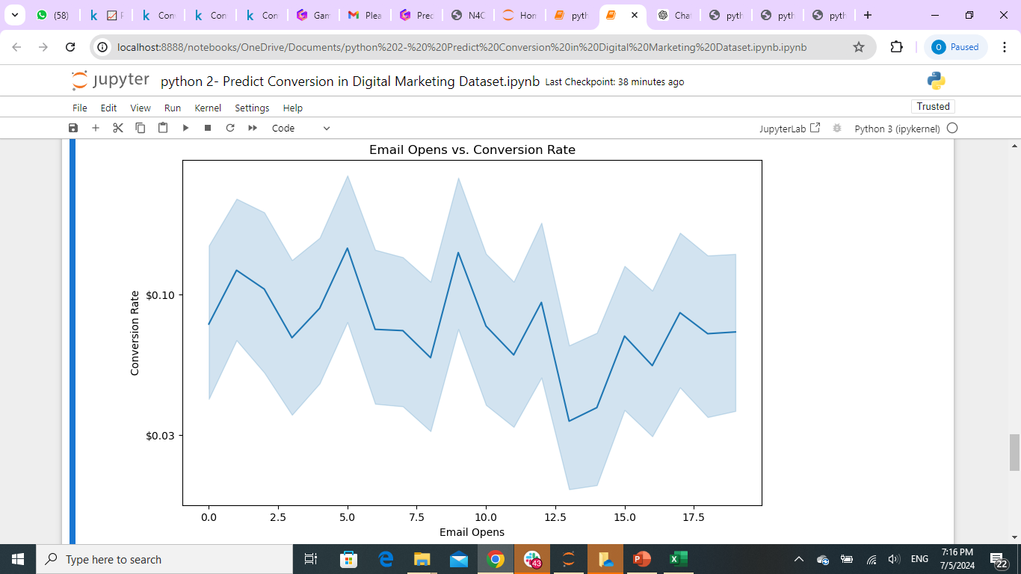
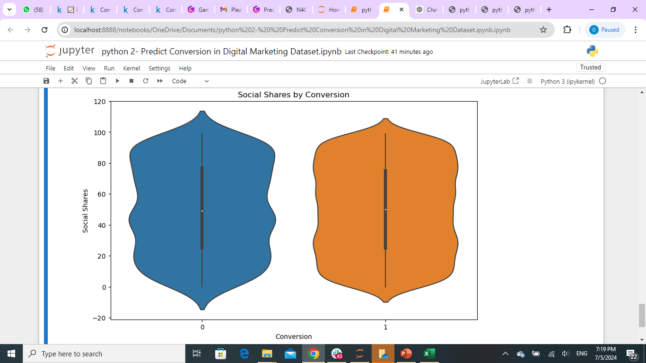
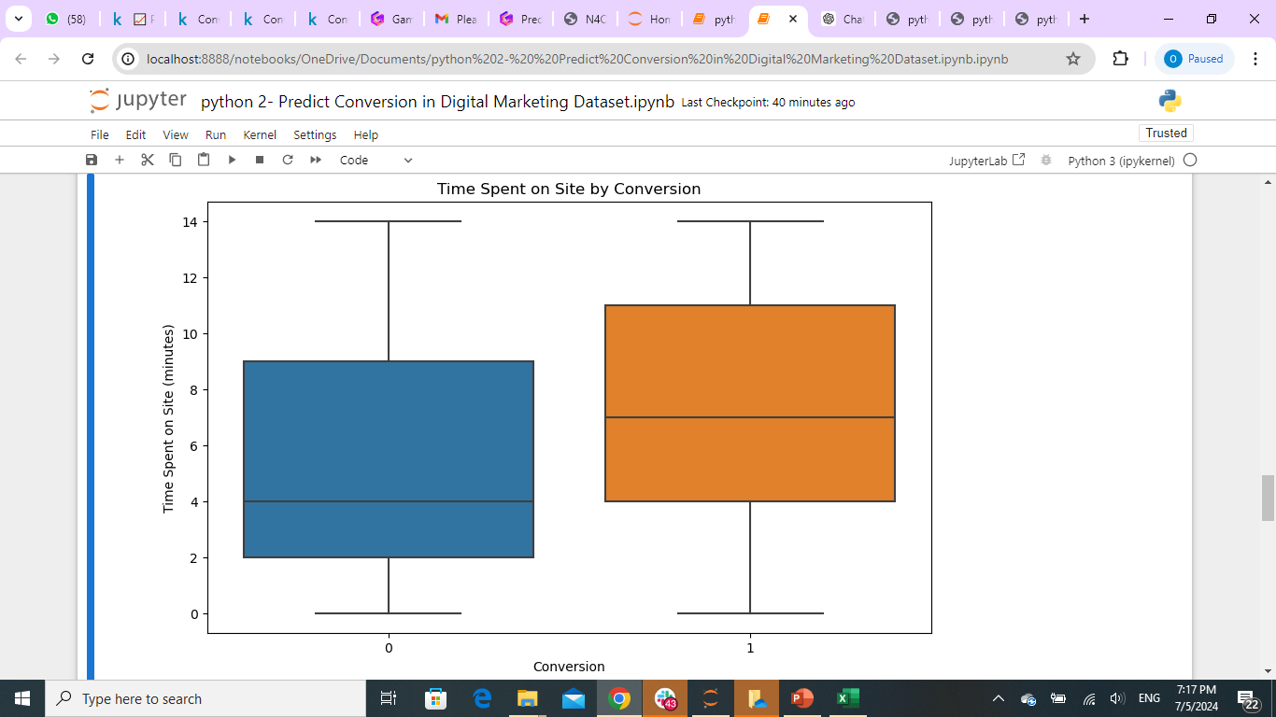
Least 6 Conversion Rate

Slide 11
Potential Applications
Campaign Planning
Use predicted conversion rates to allocate budgets, set targets, and strategize marketing initiatives.
Audience Targeting
Identify the most promising customer segments and tailor campaigns to their preferences.
Optimization
Continuously refine marketing tactics and channels based on predicted conversion performance.
Forecasting
Generate accurate revenue projections and financial planning based on predicted conversion rates.

Slide 12

THANK YOU.

